Slide 1
AIM:To find the largest number from an array using 8085 processor.
ALGORITHM:
1) Load the address of the first element of the array in HL pair. 2) Move the count to B register. 3) Increment the pointer. 4) Get the first data in A register. 5) Decrement the count. 6) Increment the pointer. 7) Compare the content of memory addressed by HL pair with that of A register. 8) If carry=0, go to step 10 or if carry=1 go to step 9 9) Move the content of memory addressed by HL to A register. 10) Decrement the count.
PROGRAM:
LXI H,2050 MOV C,M DCR C INX H MOV A,M LOOP1: INX H CMP M JNC LOOP MOV A,M LOOP: DCR C JNZ LOOP1 STA 2058 HLT

Slide 2
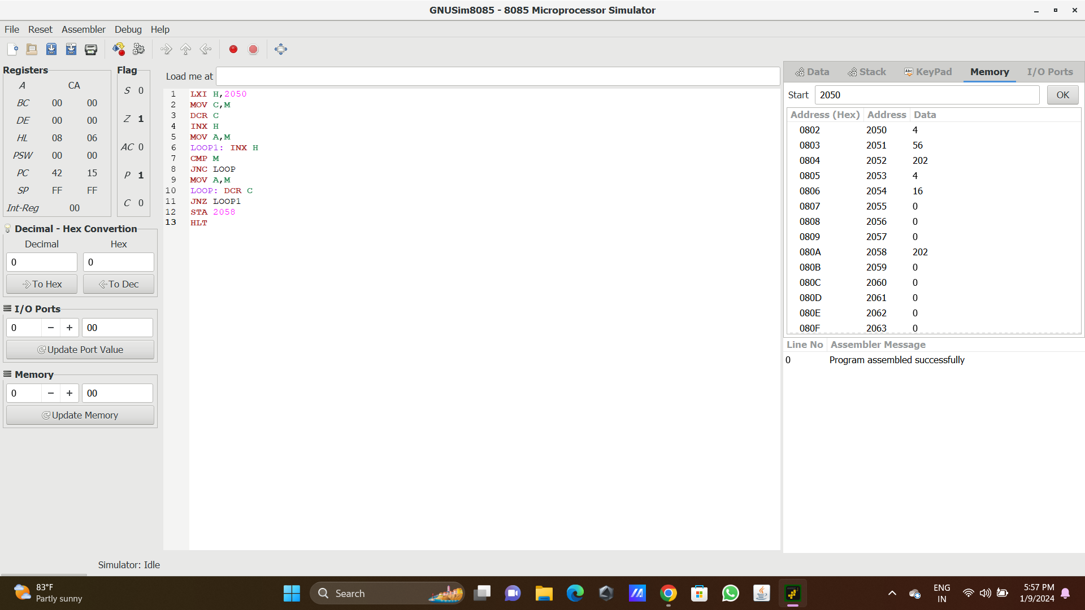
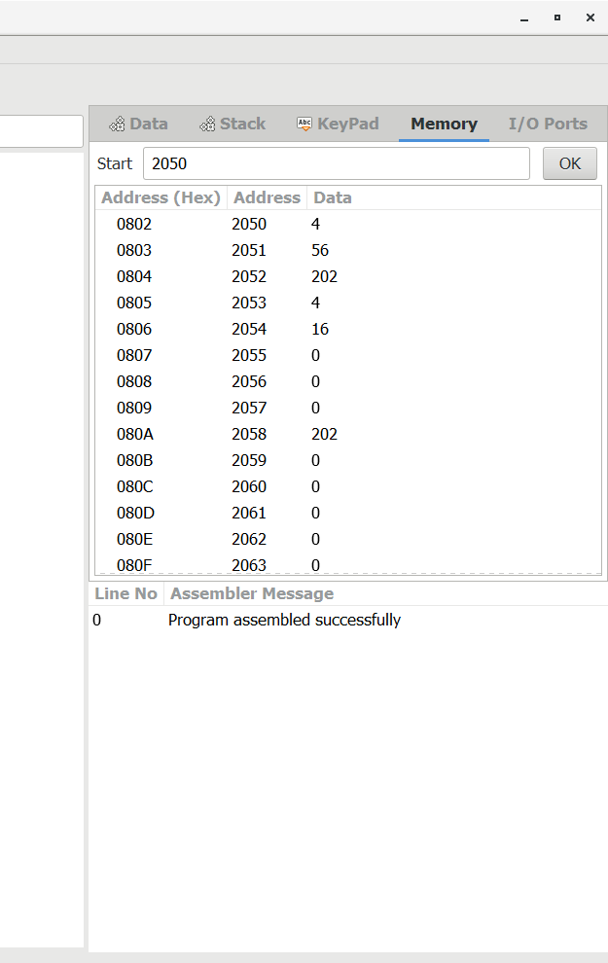
Input
output

Slide 3
RESULT: Thus the program was executed successfully using 8086 processor simulator.

